Slide 1
Does Social Media Improve
Conflict Forecasting?
A Statistical Learning Analysis Using ViEWS + Twitter Data
My · Haniya · Summer · Binayak
MATH 420 · Augustana College · Spring 2025–26

Slide 2
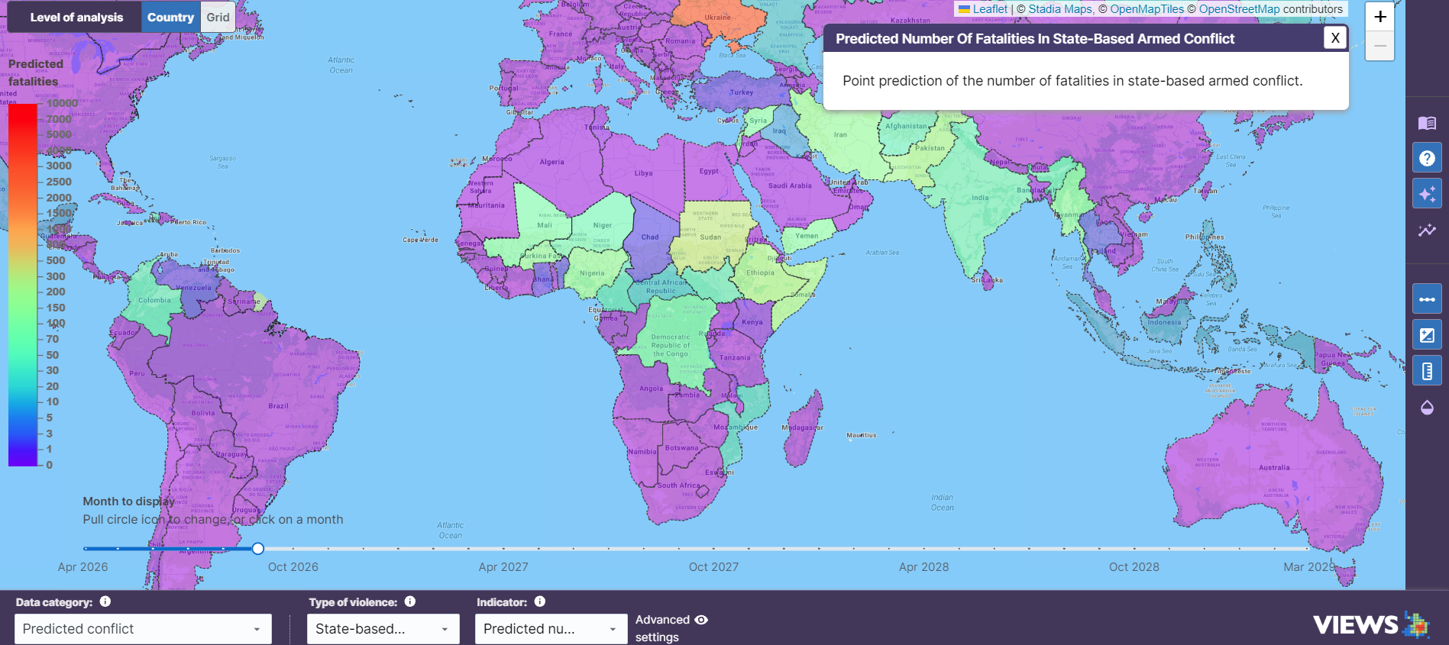
From VIEWS’s platform, the predicted probability of state-based armed conflict in Nepal in 2025 is around 0.6%. However, we know that Nepal had a very violent protest with a dozen killed in 2025.

Slide 3
What We'll Cover Today
01
The Problem
04
The Experiment
What are we trying to predict?
Baseline vs. Twitter model
02
The Data
05
The Results
Where does our information come from?
Did Twitter help or hurt?
03
The Math
06
The Takeaway
Formulas from MATH 420 we actually use
What it all means

Slide 4
The Problem: Can We Predict Political Conflict?
Stop 01 — The Problem
What is conflict forecasting?
Our question
Governments and researchers want to know:
Where is armed violence likely to happen
When might a crisis escalate?
Which countries need early intervention?
Can TWITTER speed things up?
Social media updates in real time. People tweet about protests, grievances, and unrest BEFORE official statistics catch up.
We add Twitter signals to an existing model and measure: does it predict better or worse?
Traditional approach
Systems like ViEWS use slow-moving data: GDP, past conflict, political stability — things measured yearly.
Think of it like adding a new ingredient to a recipe — does it improve the dish?

Slide 5
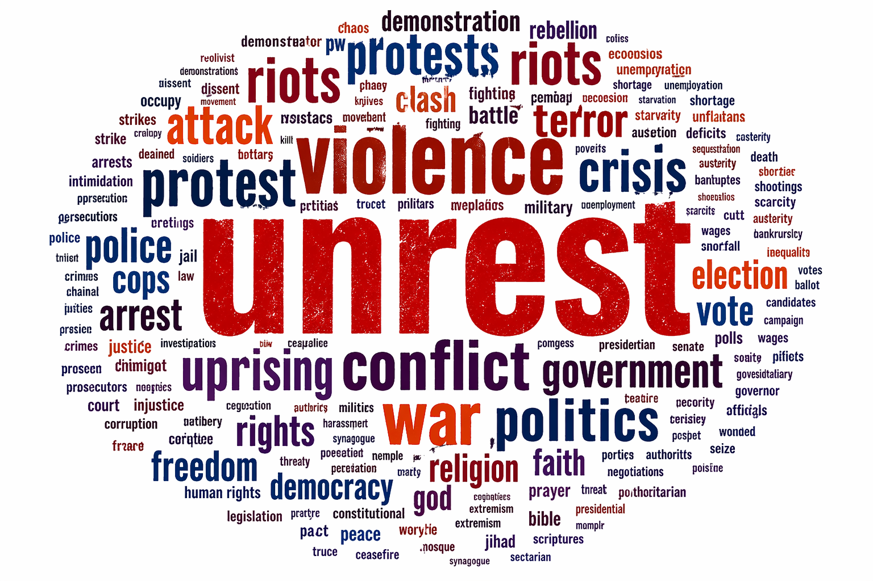

Slide 6
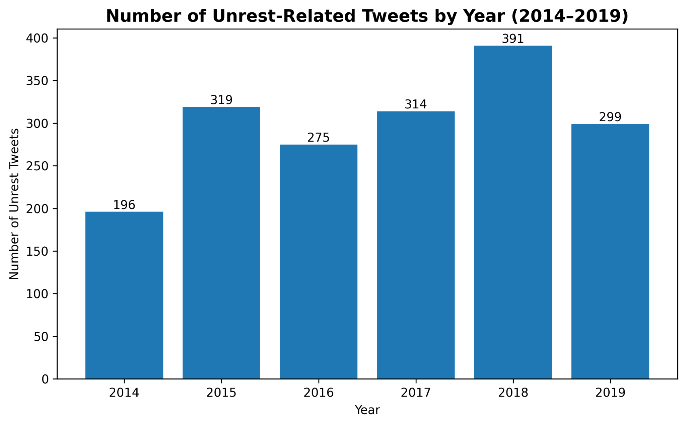

Slide 7
The Data: Two Ingredients We Combined
🌍 INGREDIENT 1: ViEWS Data
🐦 INGREDIENT 2: Twitter (CUT) Data
Country-month records going back years
Conflict history (past violence)
GDP and economic indicators
Political stability measures
Population data
4,381 annotated English tweets (2014–2019)
Each tweet labeled: unrest-related or not?
Covers protests, strikes, riots, political dissatisfaction
+
4 features we created from tweets:
Count of unrest tweets that month
Count of non-unrest tweets that month
% of tweets that are unrest-related
% of yearly unrest tweets in that month
Slow-moving. Reliable. But only updates every few months.
Notes:
We combined two data sources. ViEWS gives us the structural stuff — conflict history, GDP, political stability.
Reliable, but slow to update.
The second is the CUT dataset: 4,300 tweets from 2014 to 2019, each labeled as unrest-related or not. From those we engineered four tweet-based features. The question we're testing is — does adding the social signal in ingr 2 make the model better?

Slide 8
The Core Formula: Our Prediction Model
Multiple Linear Regression
Conflict = β₀ + β₁(Conflict History) + β₂(GDP) + β₃(Political Stability) + β₄(Population) + β₅(Twitter Unrest Count) + β₆(Twitter %) + ε
β₀ (Beta zero)
β₁, β₂, β₃, β₄
β₅, β₆ (Twitter)
ε (epsilon)
The baseline level of conflict even when all predictors are zero. Like the 'starting point'.
Numbers the model learns. Each β tells us how much conflict changes per 1-unit increase in that predictor.
The new β values for Twitter signals. If positive: more tweets → more conflict predicted.
Random error — what the model can't explain. No model is perfect; ε captures the leftover unpredictability.
Notes:
"This is multiple linear regression. Beta zero is just the baseline — conflict level before any predictors kick in. Betas one through four are the weights for your structural variables: conflict history, GDP, stability, population. The model learns those from training data.
Betas five and six are the Twitter weights — the new addition. If beta five is positive, more unrest tweets that month predicts more conflict.
The baseline model uses betas one through four. The Twitter model adds five and six. Everything else is identical.

Slide 9
How Do We Know If the Model Is Good? — RSS & MSE
🎯 Analogy: Think of darts. Each dart = one prediction. RSS measures how far all your darts landed from the bullseye, combined.
RSS = Σ (actual − predicted)²
MSE = RSS ÷ n
► Add up the squared gaps between real conflict levels and model predictions. Squaring means big mistakes hurt a lot more than small ones.
► Divide RSS by the number of country-months (n). This gives the average squared error — a single number we use to compare models.
Notes:
How do we know if a model is actually good? We measure its mistakes.
Think of darts. Each prediction is a throw, the bullseye is what really happened. RSS adds up all the misses, squared — so a really bad prediction hurts way more than a small one.
MSE is just that total divided by the number of predictions. One clean number we can compare across models. Lower means more accurate.
So when we say the Twitter model cut MSE by 24% for the Gen-Z subset — it just means those predictions got a lot closer to reality.

Slide 10
The Experiment: Baseline vs. Twitter Model
Stop 04 — The Experiment
← Model learns from this data
← Judged on this (never seen during training)
TRAINING DATA: 2014 – 2018
TESTING: 2018–2019
MODEL A — Baseline
MODEL B — Twitter-Enhanced
Conflict History
GDP / Economic data
Political Stability
Population
No Twitter features
Conflict History
GDP / Economic data
Political Stability
Population
+ 4 Twitter unrest features ← NEW
VS
Everything else is IDENTICAL — same data, same time period, same evaluation. Only difference: the Twitter features.
Notes:
"Both models trained on the same data, 2014 to 2018. Both tested on 2018 to 2019 — data they'd never seen.
Model A is the baseline: conflict history, GDP, political stability, population. Model B is exactly the same, plus the four Twitter features.
Everything else is identical. So whatever difference shows up in the results, it can only be Twitter.

Slide 11
Side-by-Side: What the Numbers Tell Us
Metric | Baseline (No Twitter) | Twitter Model (Global) | Twitter Model (Gen-Z subset)
RMSLE (Primary) | 0.648 | 0.680 ↑ | 0.630 ↓
CRPS | 9.195 / 3.540 | 9.614 ↑ | 3.168 ↓
MSE | 4219 / 80.5 | 4643 ↑ | 61.5 ↓ (~24%)
MSLE | 0.420 / 0.405 | 0.462 ↑ | 0.397 ↓
Main finding: Twitter is not universally helpful. It helps where online protest discussions closely reflect real-world instability, and hurts where they don't.

Slide 12
Results Part 1: Global Sample — Twitter Hurts
❌ Globally: Adding Twitter features made predictions WORSE across all 4 metrics
Why does this happen?
Twitter activity is uneven — some countries tweet a lot in English, others barely at all.
Twitter measures online discussion. The outcome measures actual combat deaths. Not the same thing.

Slide 13
Results Part 2: Gen-Z Protest Countries — Twitter Helps!
✅ In protest-active countries: Twitter-enhanced model performed BETTER on every metric
~24%
drop in MSE
Why does Twitter help here?
Gen-Z protest countries have younger, more online populations who actively tweet about unrest.
Online protest discussion here actually reflects real-world mobilization.

Slide 14
All MATH 420 Formulas We Used — Quick Reference
Conflict = β₀ + β₁(History) + β₂(GDP) + ··· + β₅(Twitter) + ε
Our prediction model — Multiple Regression
RSS = Σ(actual − predicted)²
How we measure total error. Model minimizes this
MSE = RSS ÷ n
Average error per observation — our main comparison metric

Slide 15
Future Improvement: What Could Be Better
English-only tweets
Simplified model
🗣️
🤖
Many countries don't tweet in English. We're missing large parts of the world.
Our model is inspired by ViEWS but is much simpler than the real system.
Twitter ≠ all social media
Country selection
📱
🌍
Facebook, TikTok, and local platforms may be more relevant in many countries.
The Gen-Z protest subset was chosen theoretically — needs validation.
Tweets measure unrest, not conflict
Future work
🎯
📐
Protests don't always become armed violence. Different outcomes.
Direct Ridge/Lasso comparison with cross-validated λ would strengthen the math.

Slide 16
Conclusion: What We Learned
1
More data ≠ better model
Adding Twitter features globally HURT performance. Extra predictors add noise if they don't carry real signal.
2
Context matters enormously
The same 4 Twitter features that hurt globally improved MSE by ~24% in Gen-Z protest countries. The data has to be relevant to the problem.
3
Real-time data is the next frontier in conflict forecasting
Traditional models are built on data that updates yearly. Social media updates by the minute.

Slide 17
Thank You!
Questions?

